Slide 2
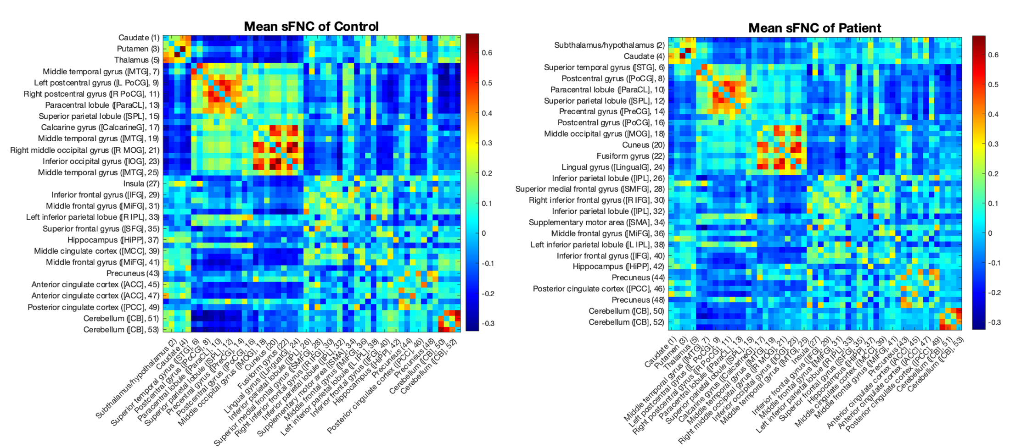
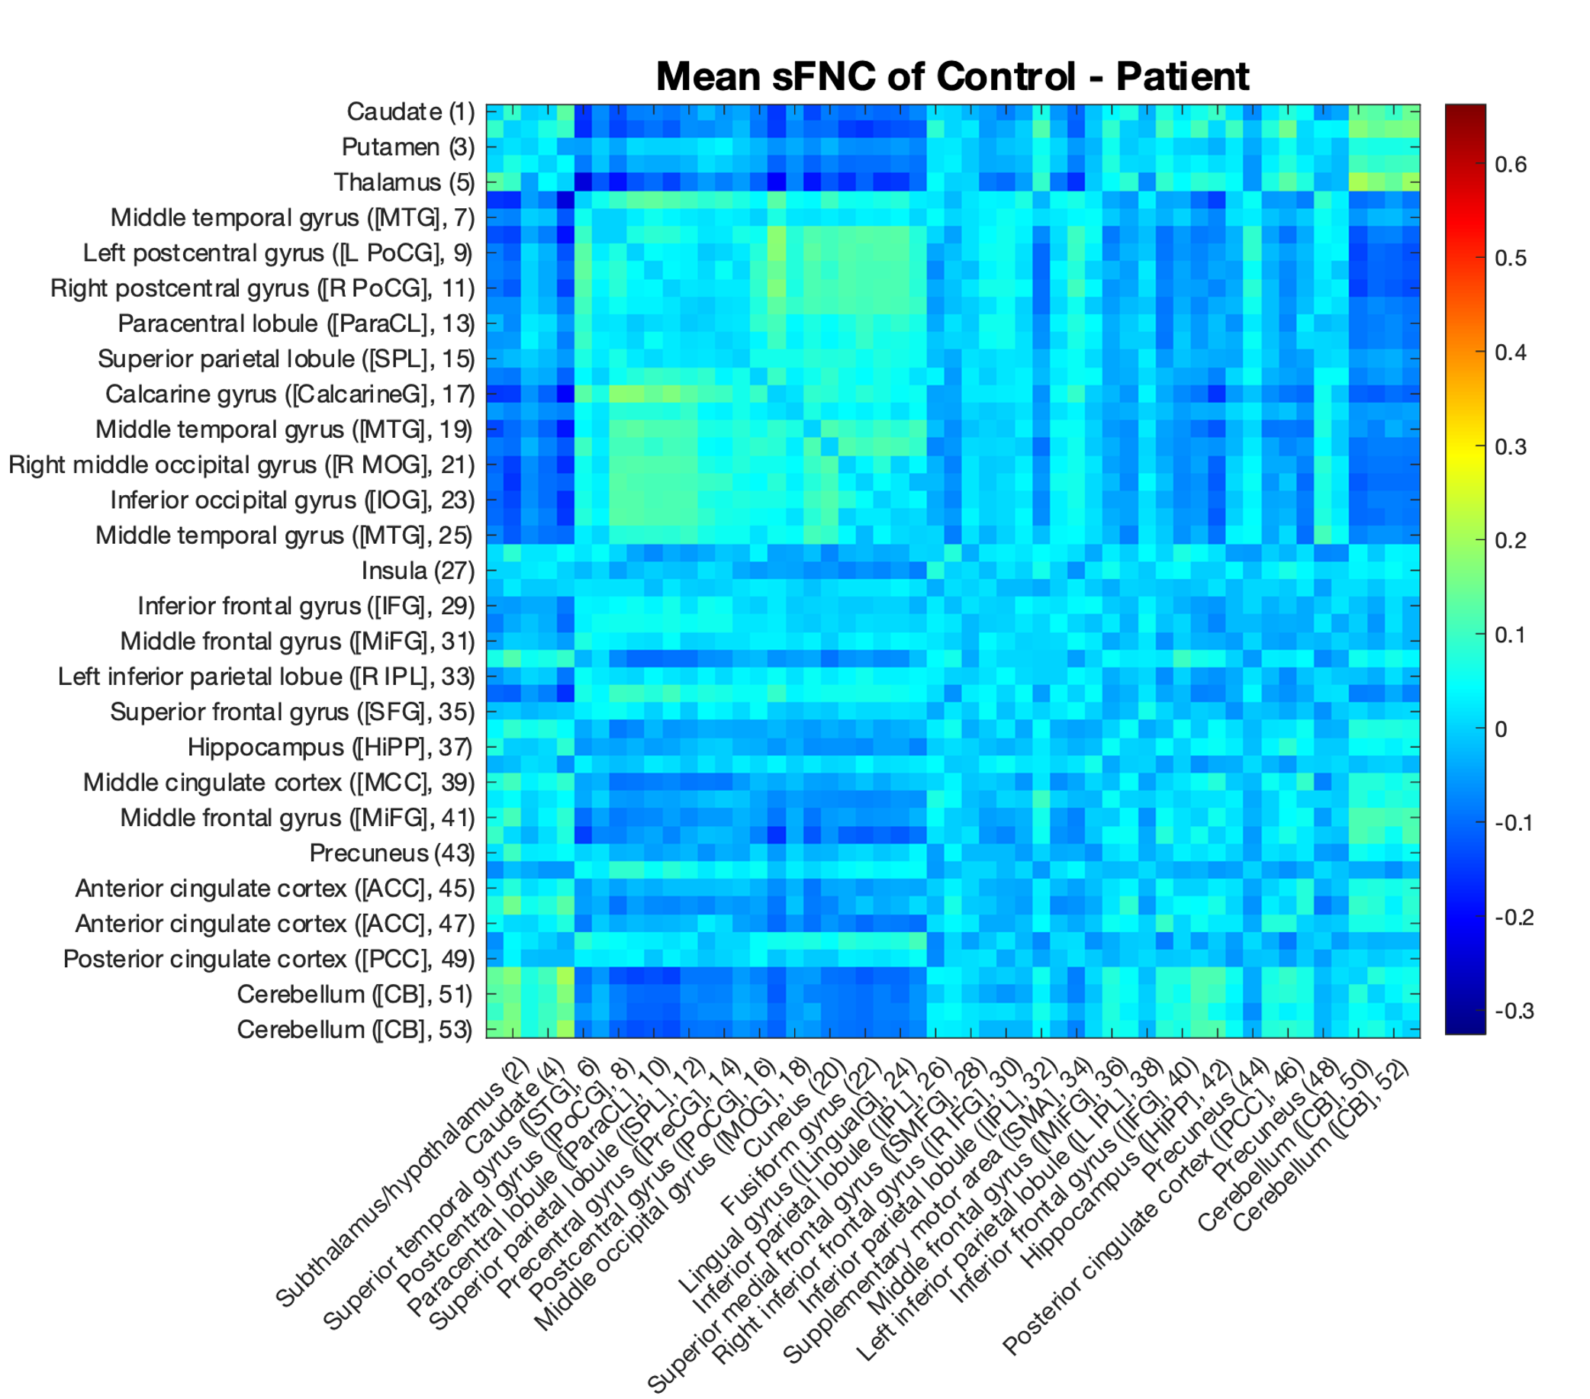
A) Mean sFNC of Controls
B) Mean sFNC of Patients
C) Mean sFNC of Patients-Controls
Notes:
Static functional network connectivity (sFNC) analysis was mainly conducted as a sanity check to ensure that the received data were indeed the same as that reported in Du et. al. 2020 and that the author had reconstituted the matrices correctly. Panel (A) displays the average sFNC of controls in the selected dataset, while panel (B) displays the average sFNC of schizophrenia patients. A visual inspection demonstrates that both (A) and (B) display the block structure characteristic of sFNC matrices common in the functional imaging literature. As in Du et. al. reported this structure, it appears that the FNC matrices have indeed been correctly reconstructed.
The author observed that controls seem to display a larger range of correlation coefficient values, with higher magnitudes for both positive and negative values. To examine this, he subtracted the patient average sFNC matrix from the control average matrix. A visual examination of the resulting connectivity difference matrix does indeed suggest higher magnitude correlation coefficient values in the control population, particularly between negatively correlated areas. This reduced oppositional coupling may be relevant for future schizophrenia studies. The author suggests searching for population-level differences in subject sFNCs using the network-based statistic or other network-specific difference tests.

Slide 4
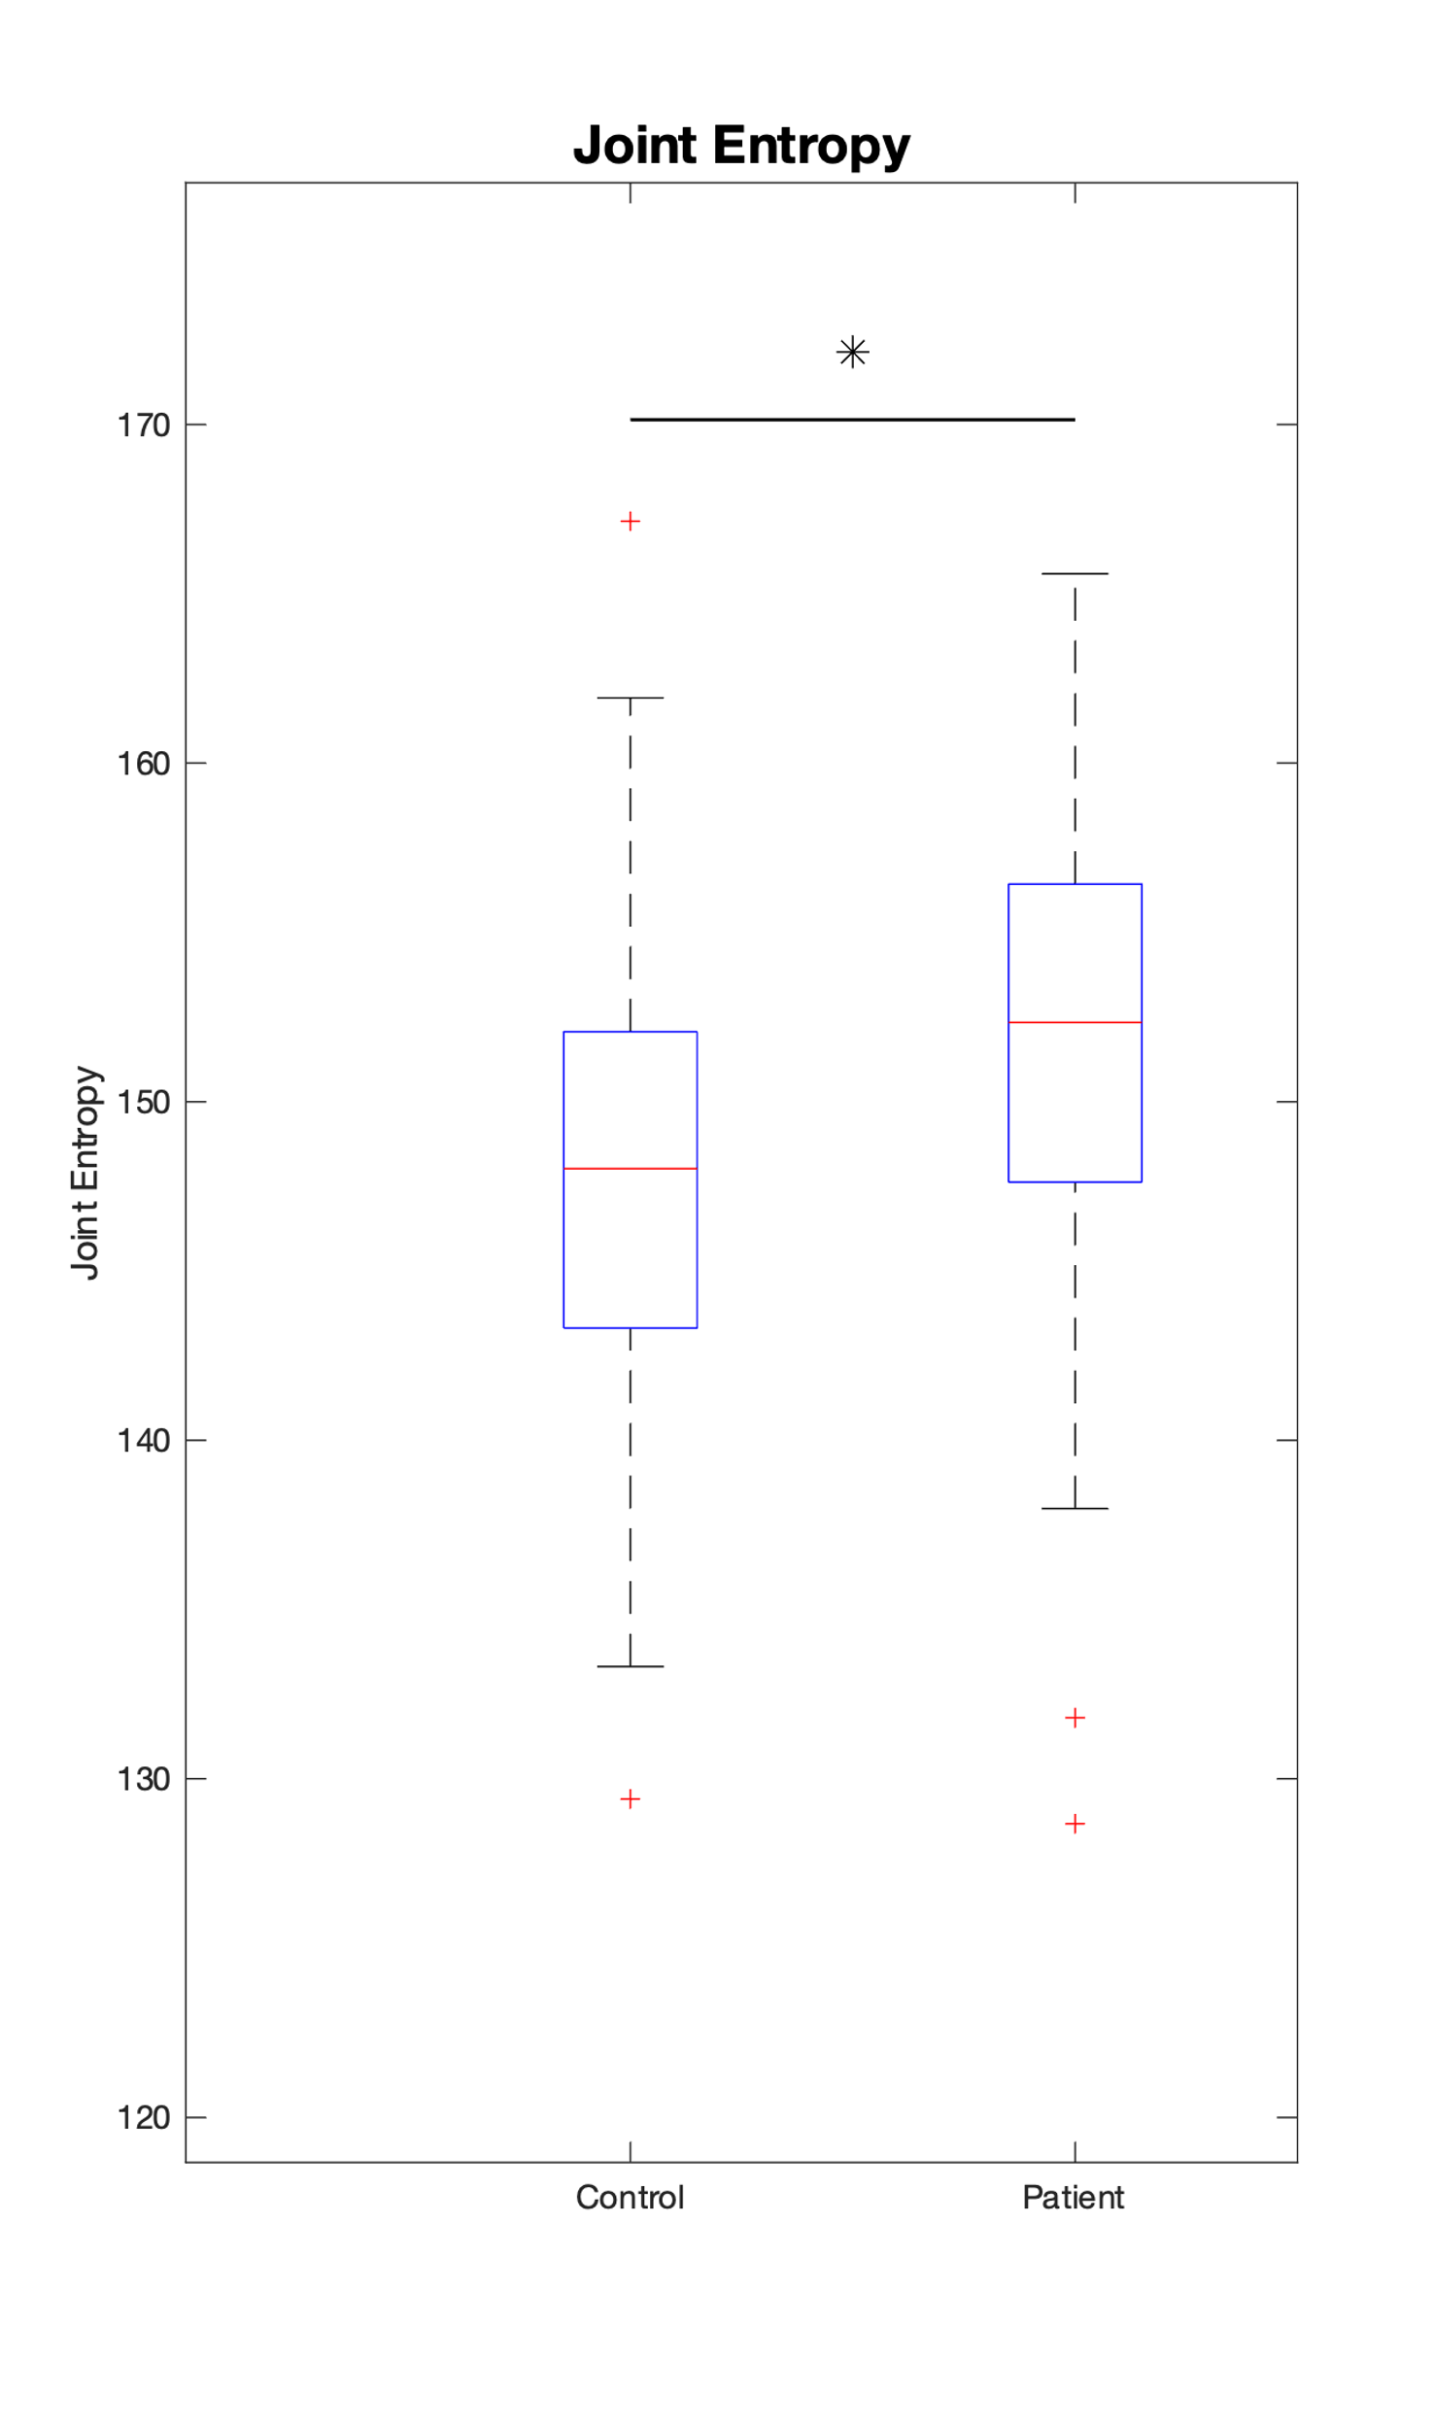
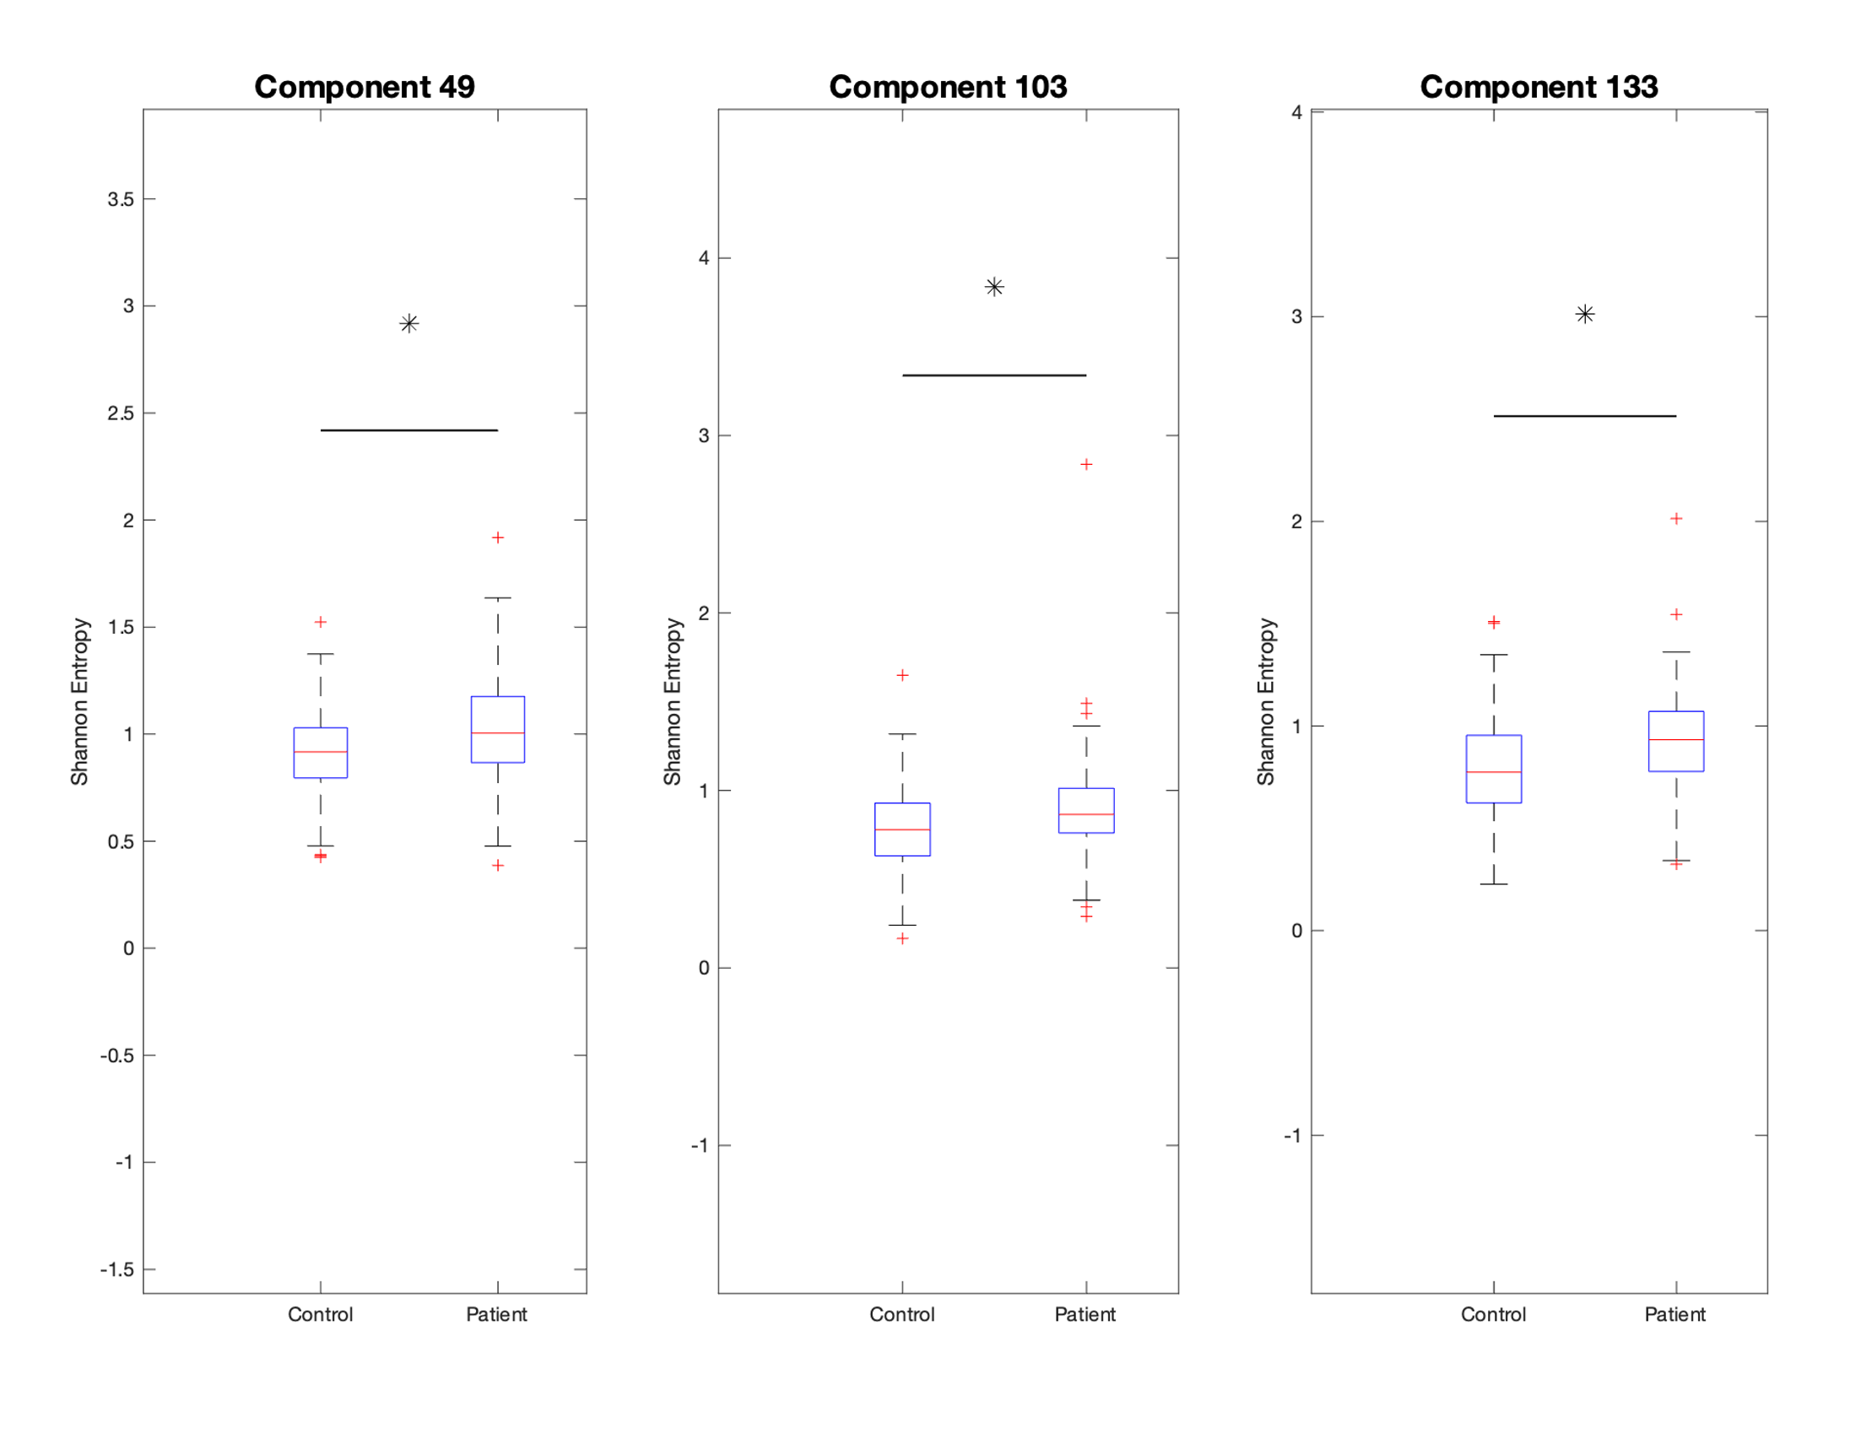
A) Joint Entropy
B) Component 49
C) Component 103
D) Component 133
Joint Entropy
Entropy
Entropy
Entropy
Notes:
Upon estimating the entropy of all subjects’ temporally independent components, a Kolmogorov-Smirnov two-sample test demonstrates that schizophrenia patients tend to display significantly higher entropy than the control group (A). These differences are not evenly spread throughout all components; instead, three components display statistically significant entropy elevations in the patient population (B, C, D). It thus appears that schizophrenia affects specific components (meta-states, if you will) of the human brain’s functional connectivity, which may offer a path for further investigation and treatment.

Slide 5
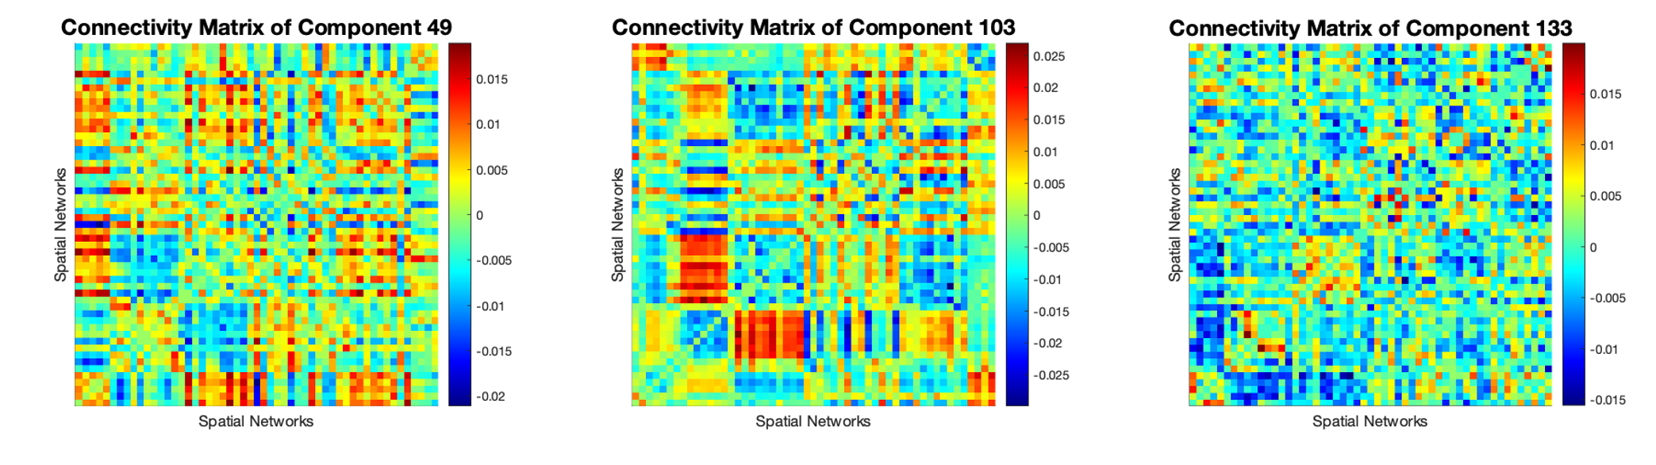
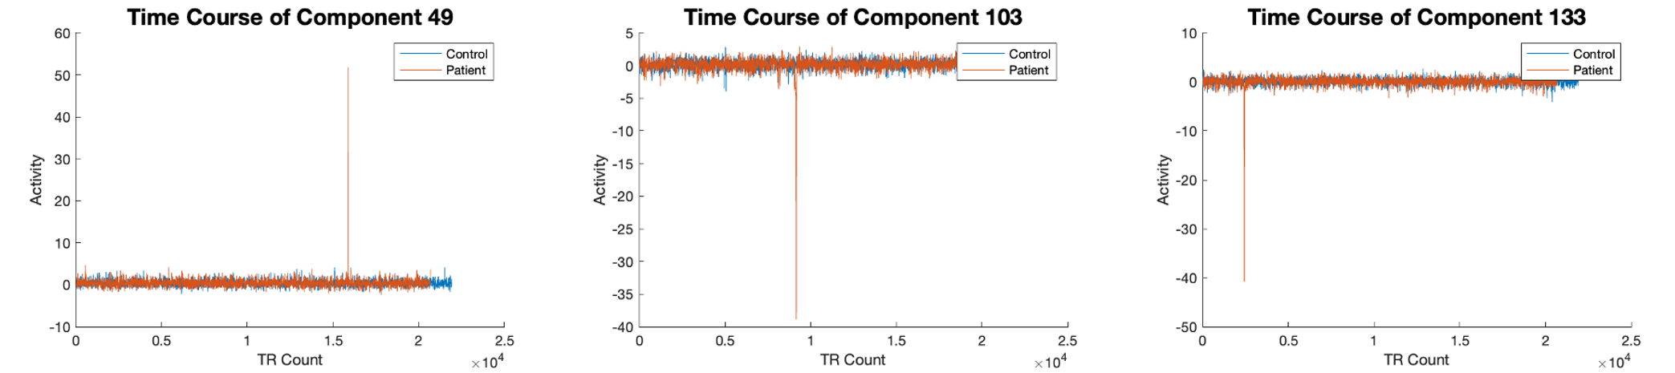
Component 49
Component 103
Component 113
A)
C)
Connectivity Matrix
Connectivity Matrix
Connectivity Matrix
B)
D)
Time Course
E)
Time Course
F)
Time Course
Notes:
The connectivity matrices and time courses of the three components which display elevated entropy. Component 49 (A: connectivity matrix; D: time course) displays a weak block structure. A different block structure is evident in Component 103 (B: connectivity matrix; E: time course). Component 113, on the other hand, has very weak structure (C: connectivity matrix; F: time course) everywhere except in the bottom left corner, where a weakly anticorrelated block is visible.
All three components’ connectivity matrices appear to be symmetric about the anti-diagonal (running from left bottom to right top corner). This may suggest an error in reconstructing the sFNC matrix, as these matrices typically display symmetry about the main diagonal. The author wishes to examine the reconstruction for possible errors.
All three components’ time courses display singular, very large activations during one subject’s scan. These spikes in activity do not seem to follow an obvious pattern, but all appear in patient, rather than control, time courses. The consistency of their appearance and their presence in patients alone suggests that these spikes may be the primary driver of elevated patient entropy in the selected temporal components. If so, the author suggests an effort to confirm that these spikes accurately represent the underlying data, as it is possible that they are artifactual.

Slide 6
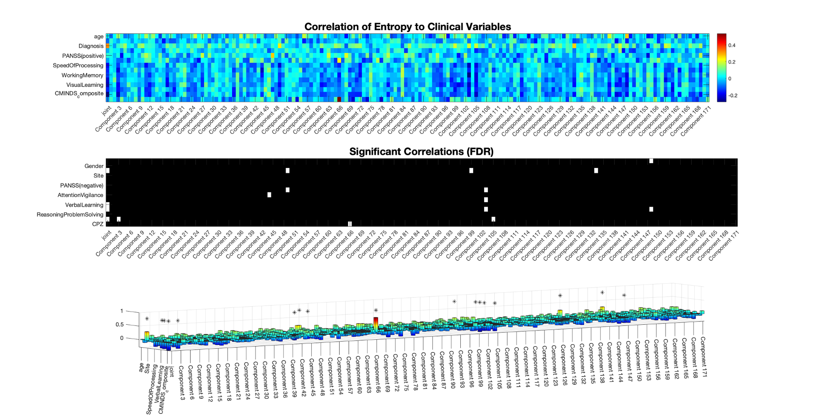
A)
B)
C)
Notes:
The discovery of scanner-detectable disease markers is one of the fundamental goals of modern neuroimaging. As such, the decision to examine the correlation between diagnosis and entropy (joint and component-level) was an obvious one to take. Researchers are also searching for other neuroimaging scores which correlate with clinical or behavioral variables (A). Within the variable-component matrix, seventeen correlation coefficients survive false discovery rate multiple comparison correction (B). These cover a considerable range of components and clinical variables(C).

